Slide 1
K-Means Clustering for FIFA Player Analysis
05
11
37
Adnan Ansari
Mikhail Cazi
Vishal Naidu

Slide 2
Given the ages and international rankings of ‘n’ FIFA players, group them into ‘k’ clusters to help uncover patterns between their age and rating
Problem Statement

Slide 3
Java
Python
Languages Used

Slide 4
Dataset
The dataset contains 15000+ records of international football players, in order of their FIFA ratings
Each record has 53 attributes associated with each player in a Comma Separated Value (CSV) format
Of these attributes, we have used the age and the FIFA ranking of the player to make the clusters

Slide 5
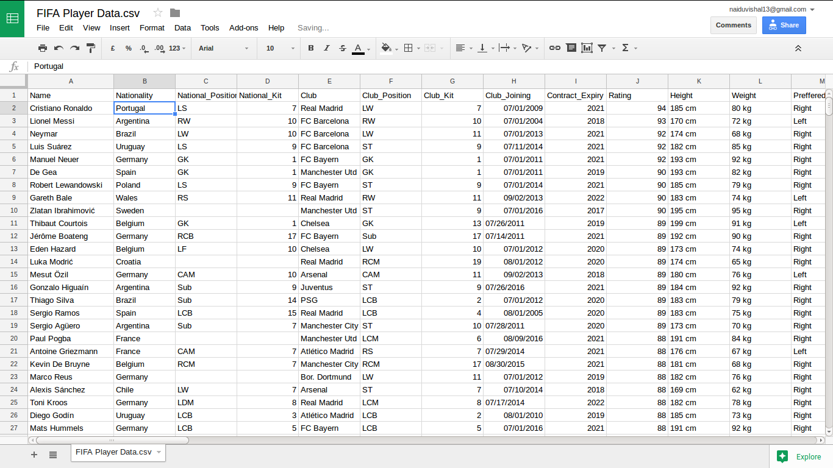

Slide 6
Working
As per the K-means partition clustering algorithm, the number of target clusters (k) is taken from the user
After selecting the initial k means, the algorithm keeps grouping points into the nearest cluster, based on the Euclidian distance
The mean of each cluster is then updated and the above step is repeated
This is repeated 1 million times, or until stable clusters are formed (whichever is smaller)

Slide 7
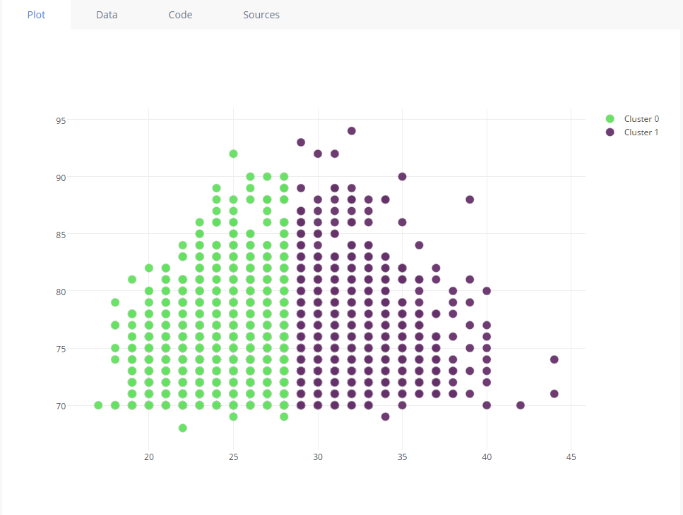
Visualization - 2 Clusters

Slide 8
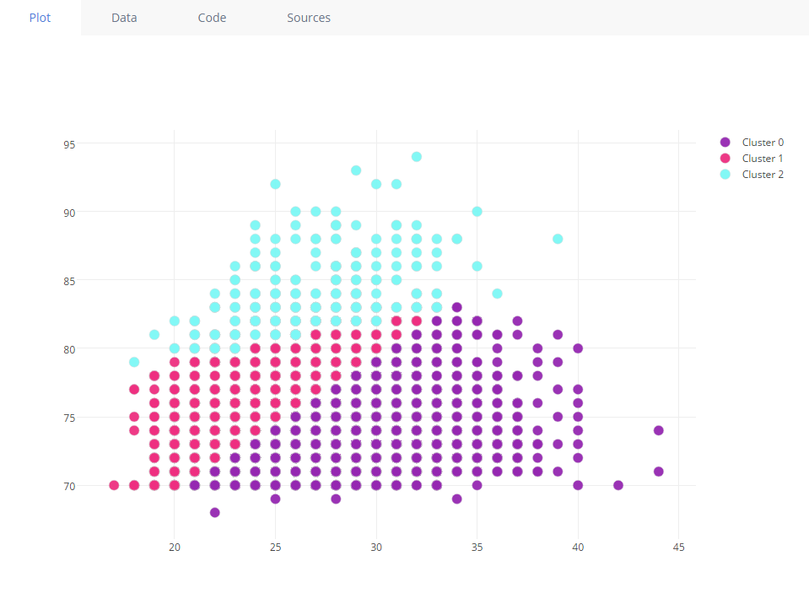
Visualization - 3 Clusters

Slide 9
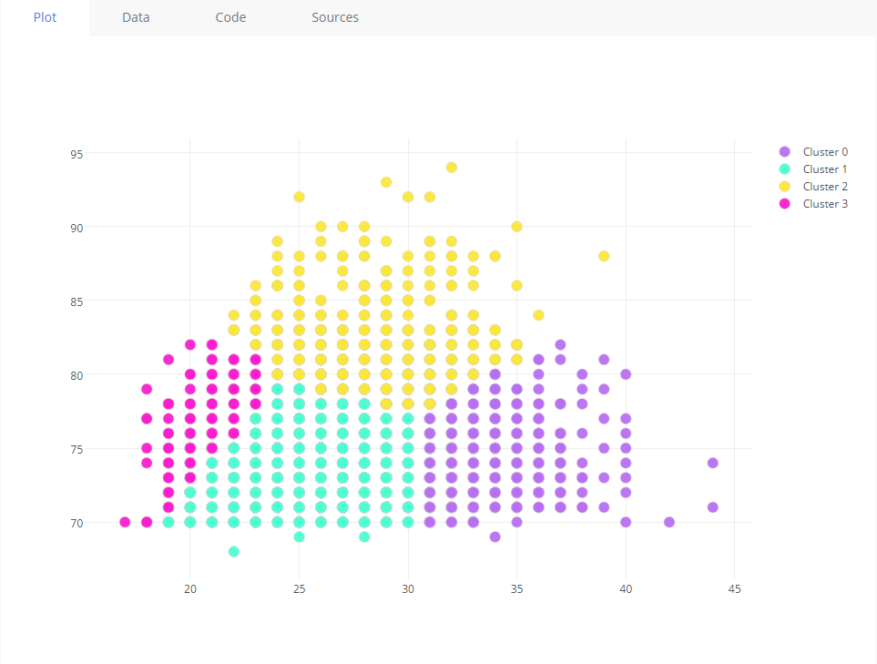
Visualization - 4 Clusters

Slide 10
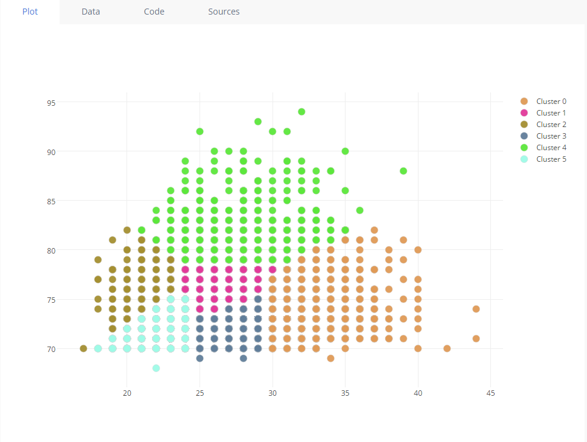
Visualization - 6 Clusters

Slide 11
The inference drawn from the 6-Cluster Scatter Plot on the previous slide is:
BI Decision

Slide 12
Best Packs (from plot in slide 9)
Cluster 4 (Green)
Very high performance Highest transfer cost Reliable contract length
Cluster 2 (Dark Brown)
Young players High scope of improvement Lack of experience Reliable contract length
Cluster 5 (Dark Brown)
Players with high experience and age So, contract length unreliable Great ability to read the game

Slide 13
Thank you

